Slide 1


UpAIsthiti:
A Touchless Attendance System
Project Mentors :
Mrs. Priya R.L ,
Mrs. Nusrat Ansari
Group Number : 31
Group Members : Manigandan K D17A 47
J N Guru Akaash D17A 28
Ajay Nair D17A 55 Varun Tripathy D17A 69

Slide 2
Content
Task Assigned -
Hardware, Software, tools and constraints
Challenges Faced
Results and implementation screenshots
References

Slide 3
Task Description
What is UpAIsthiti?
UpAIsthiti is an touchless attendance system supported by Artificial Intelligence which records the attendance just by capturing faces and does not require any kind of contact with the attendance system as opposed to the traditional systems. The application will capture the faces of students/employees through video feeds and these faces would be processed with the help of image processing. Further, with the help of face recognition models, it will identify the faces and record the attendance in the software itself.
Our Task:
Our task was to study how UpAIsthithi was implemented and to implement it ourselves on our local machines. We were also assigned to study how the model worked by using live feed from a webcam and to testing it ourselves.

Slide 4
Hardwares and Softwares Used:
Hardware:
Laptop/OS:
The application was build on Ubuntu OS but it can easily work with any other OS with a good laptop.
WebCams/Mobile:
This application requires input in the form of videos hence webcams/mobile cameras are required to feed the video to the application.
Software:
Python:
The server of this application was built on Python along with the aid of various libraries of python.
OpenCV-
This library for processing the images and frames captured from the videos.
PyQt5-
The UI of our application was made on PyQt5 which is a GUI widgets toolkit.
Java-
Java was used for implementing the client side of the system.

Slide 5
Challenges Faced
Module Not Found Error:
The face_recognition module used to process the faces with the live feed always gave us ModuleNotFoundError Exception even though the module already exists in the environment. To solve this problem we had to uninstall that package then install the pip3 module and reinstall the package .
The following commands were used:
pip3 uninstall <Module>
sudo apt-get install python3 python3-pip
sudo apt-get install python3-<Module>/
sudo pip3 install <Module>

Slide 6
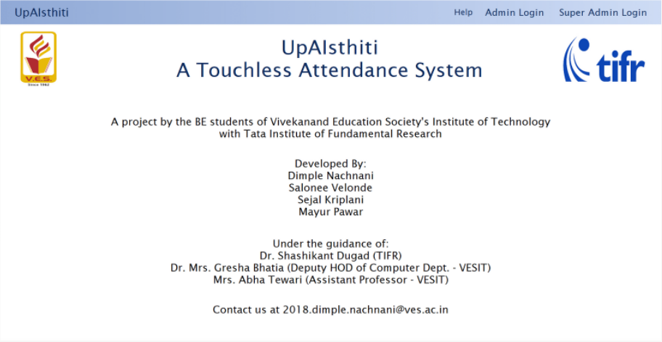
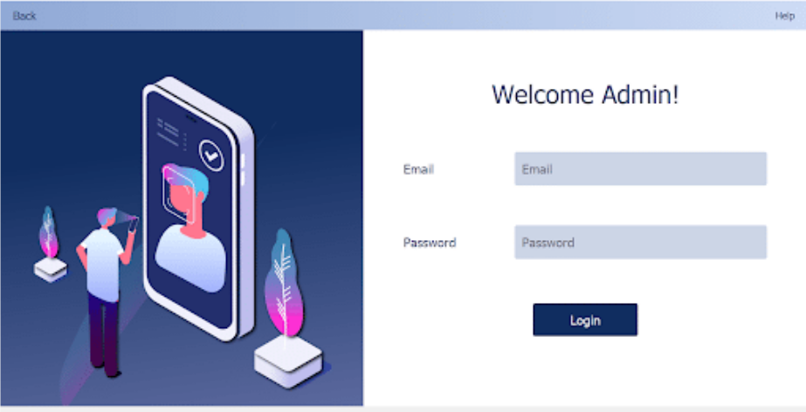
Results and Screenshots
Landing Page:
Login Page:

Slide 7
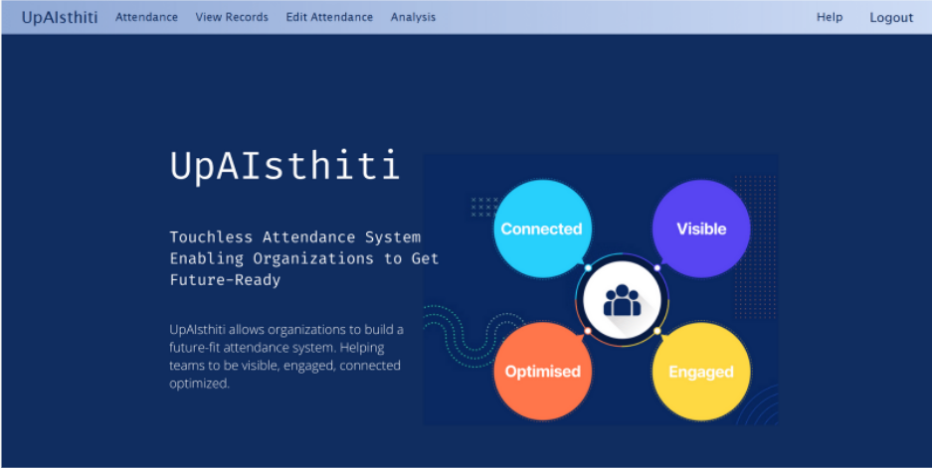
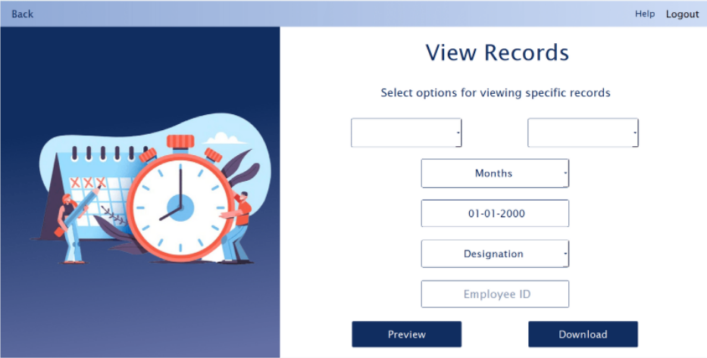
Results and Screenshots
Home Page:
View Records:

Slide 8
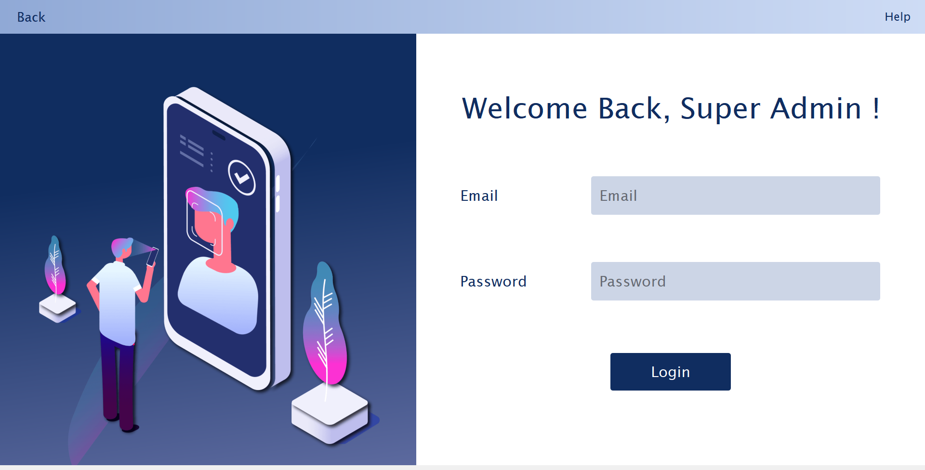
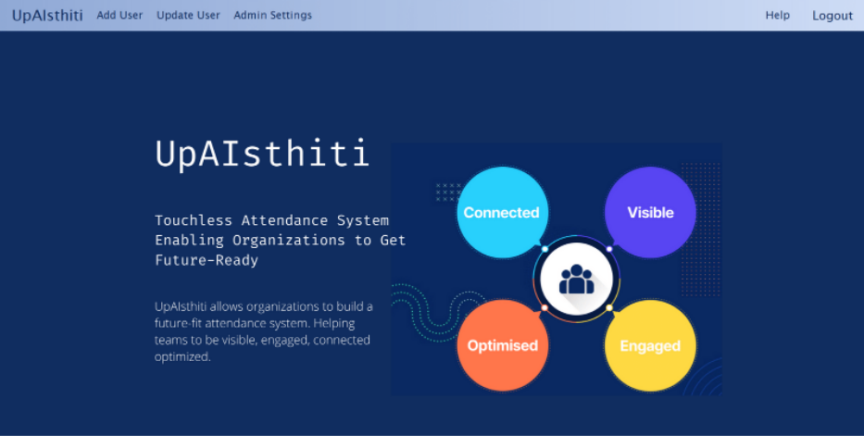
Results and Screenshots
Super Admin Page:
Home Page:

Slide 9
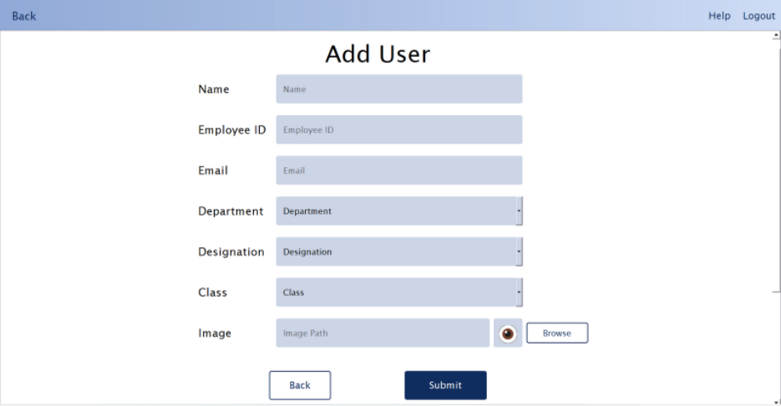
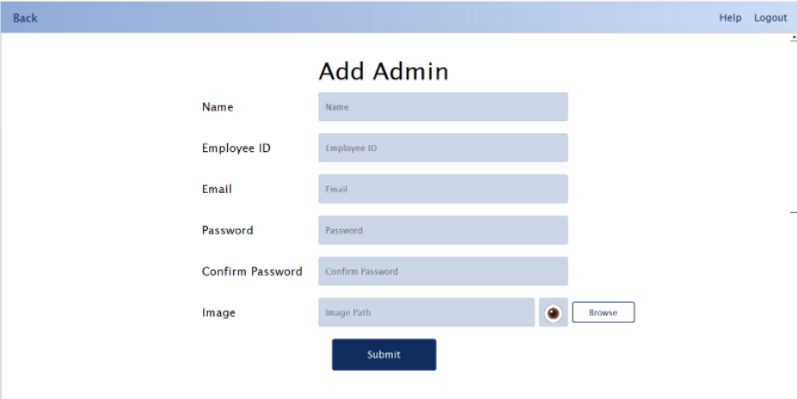
Results and Screenshots
Add Users:
Add Admins:

Slide 10
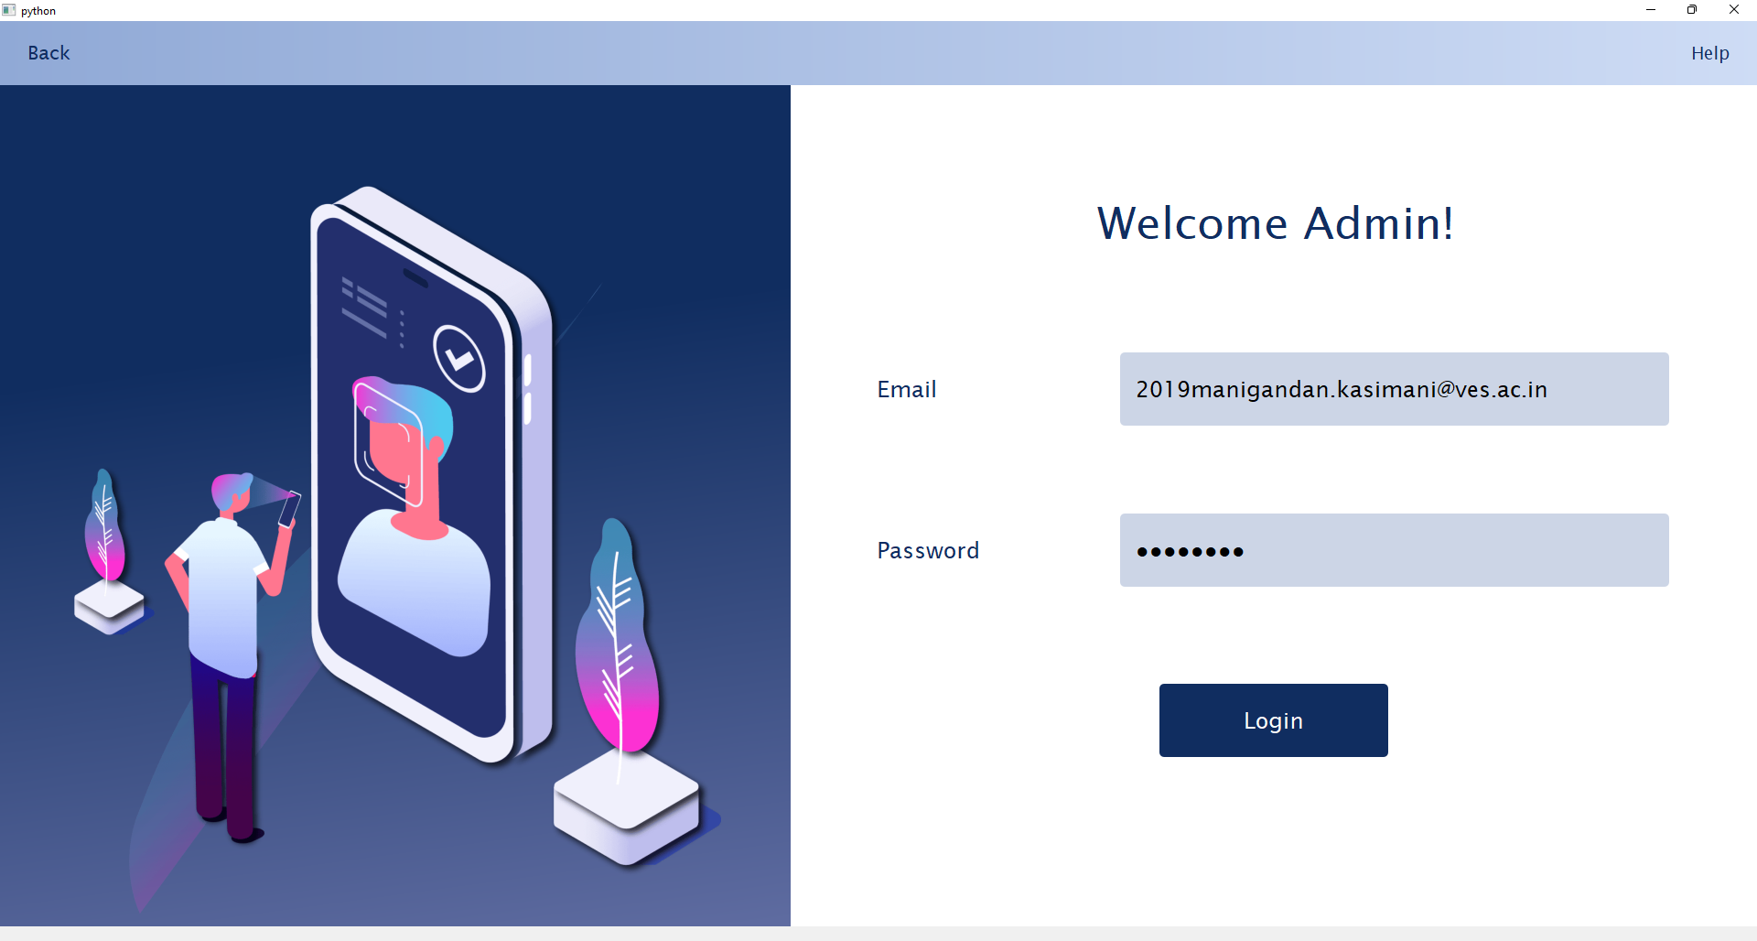
Results and Screenshots
Admin Login:

Slide 11
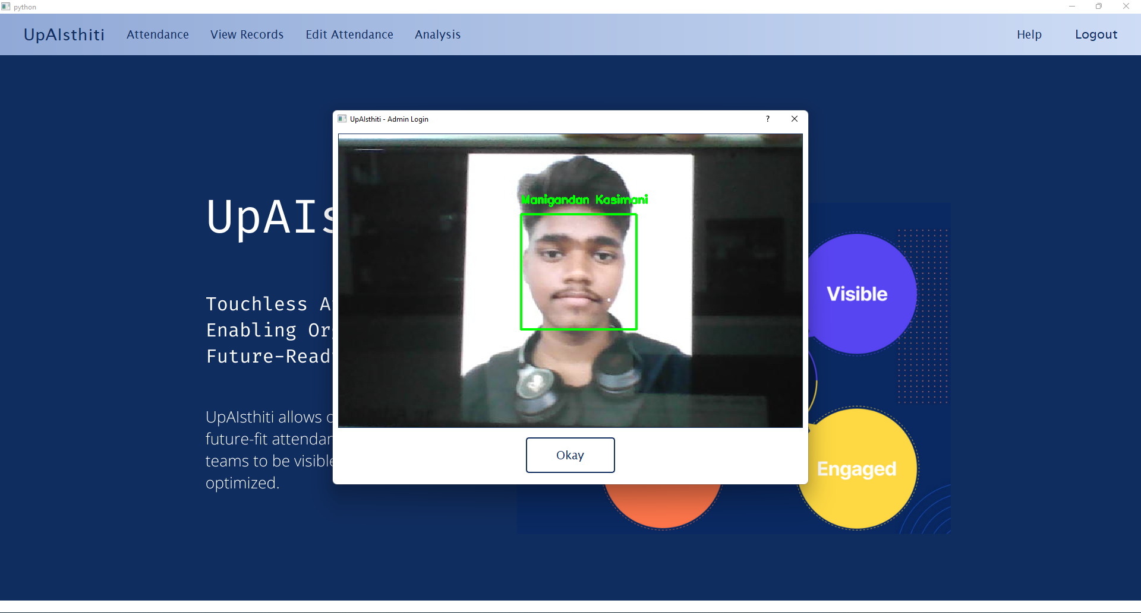
Results and Screenshots
Face Detection:

Slide 12
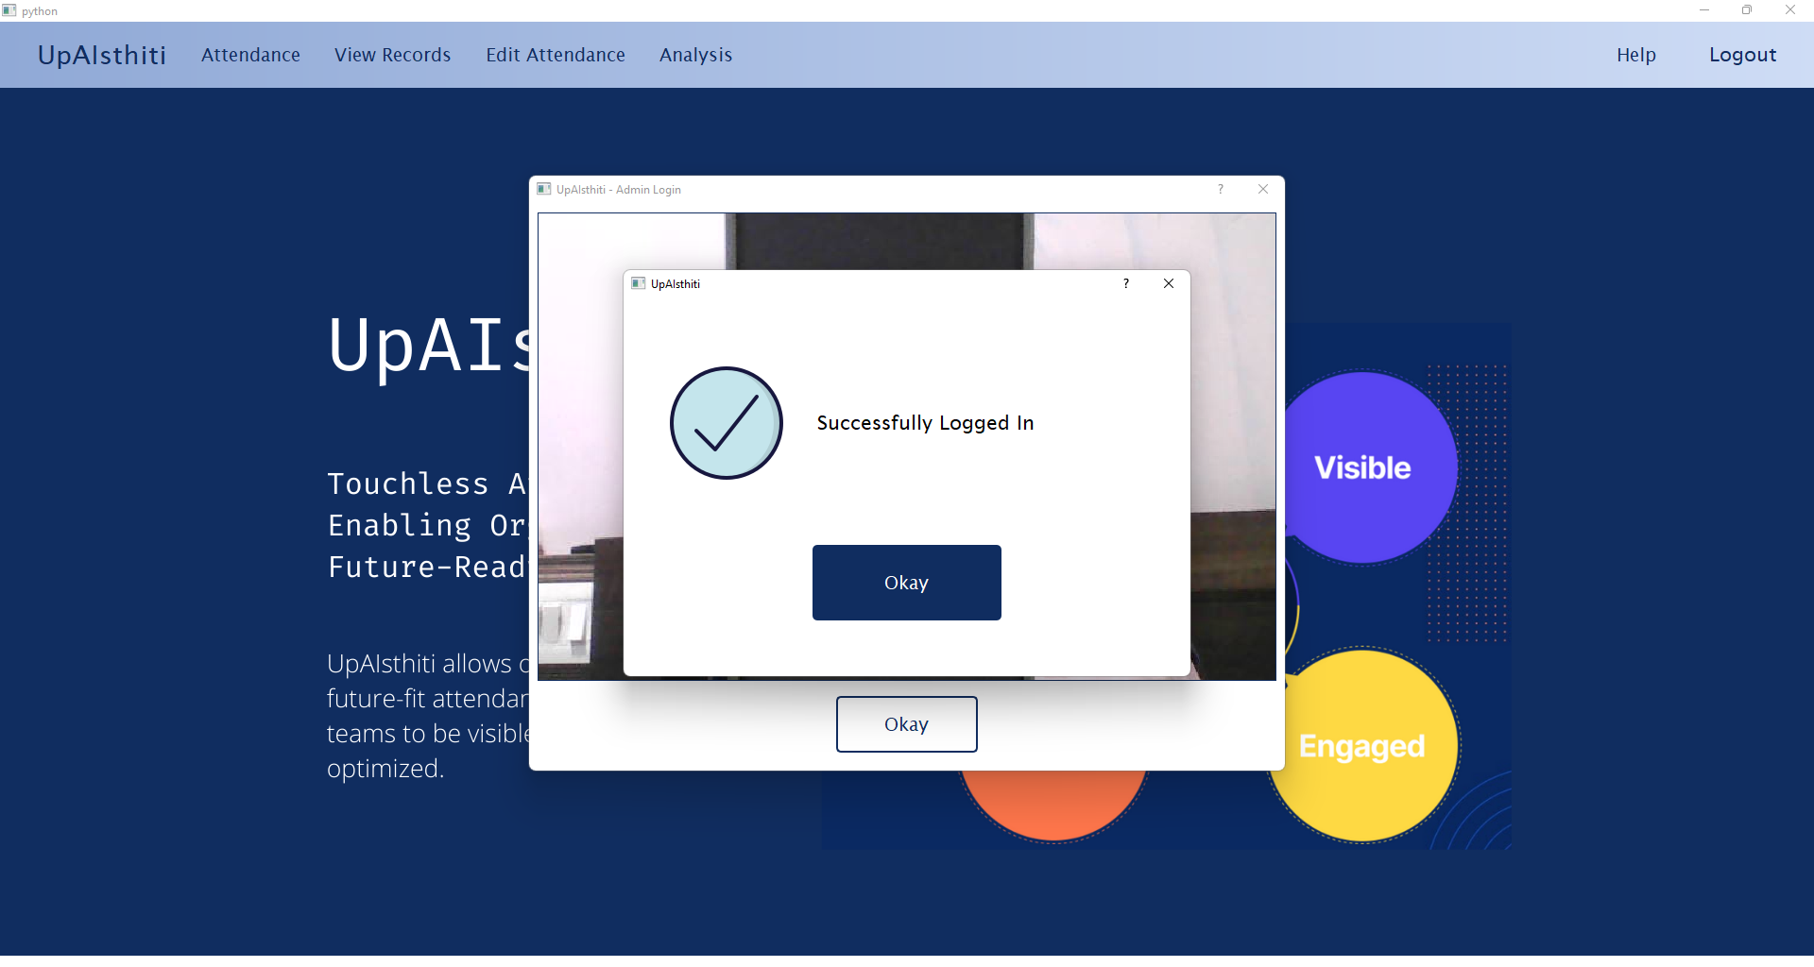
Results and Screenshots
Successful Login:

Slide 13

Results and Screenshots

Slide 14
References:
CookBook UpAIsthiti_A Touchless Attendance System
CookBook UpAIsthiti
[1] Shehu, Visar, and Agni Dika. "Using real time computer vision algorithms in automatic
attendance management systems." Proceedings of the ITI 2010, 32nd International Conference
on Information Technology Interfaces. IEEE, 2010.
[2] Viola, Paul, and Michael J. Jones. "Robust real-time face detection." International journal of
computer vision 57.2 (2004): 137-154.

Slide 15
Aatmanirbhar Sanchar:
Self-Sufficient Communications
Project Mentors :
Mrs. Priya R.L ,
Mrs. Nusrat Ansari
Group Number : 31
Group Members : Manigandan K D17A 47
J N Guru Akaash D17A 28
Ajay Nair D17A 55 Varun Tripathy D17A 69

Slide 16
Content
Task Assigned
Hardware, Software, tools and constraints
Challenges Faced
Results and implementation screenshots
References

Slide 17
Task Assigned
What is “Aatmanirbhar Sanchar”?
Aatmanirbhar Sanchar is chat application which provides the users a real time off the grid, secure and anonymous messaging service. This application was built without any third party API and it is a cross-platform ephemeral anonymous messaging service providing End to End encryption while also enabling secure transmission of any kind of data files including but not limited to images, videos, and documents.
Our Task:
Our task was to study how this application was implemented and to implement it ourselves on our local machines. We were also assigned to study and test the various features of the applications and how it was implemented.

Slide 18
Hardwares and Softwares Used:
Hardware:
Laptop/OS:
The application was build on Ubuntu OS but it can easily work with any other OS with a good laptop.
Network:
Require a Static IP Address with at least 5 open ports.
Software:
NPM: Version 6.14.14 or above
Npm is used to install packages required to build the project.
NodeJS: Version 14.17.5 or above
ReactJs
ReactJs is used to build the UI of the application

Slide 19
Challenges Faced
Static IP:
The biggest challenge with this project was to setup the Static Ip, the static ip address assigned to us was not working and the ports in the ip address were closed. As a result, we had a lot of issues, but after the static IP, other sections were easy to install.
Minimum SDK version:
We encountered a minimum SDK version error while implementing the code for the mobile application. We tried changing the sdk version everywhere, but the application continued to give the same error. After some research, we learned that we needed to make changes in a hidden properties file, and after doing so, the app began to work properly.

Slide 20
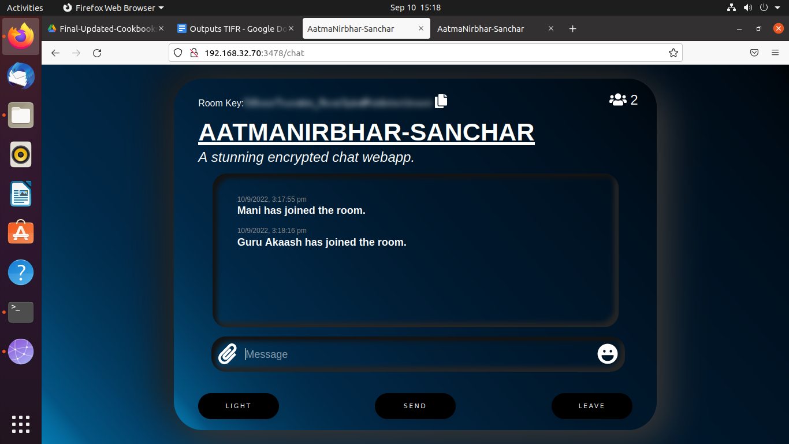
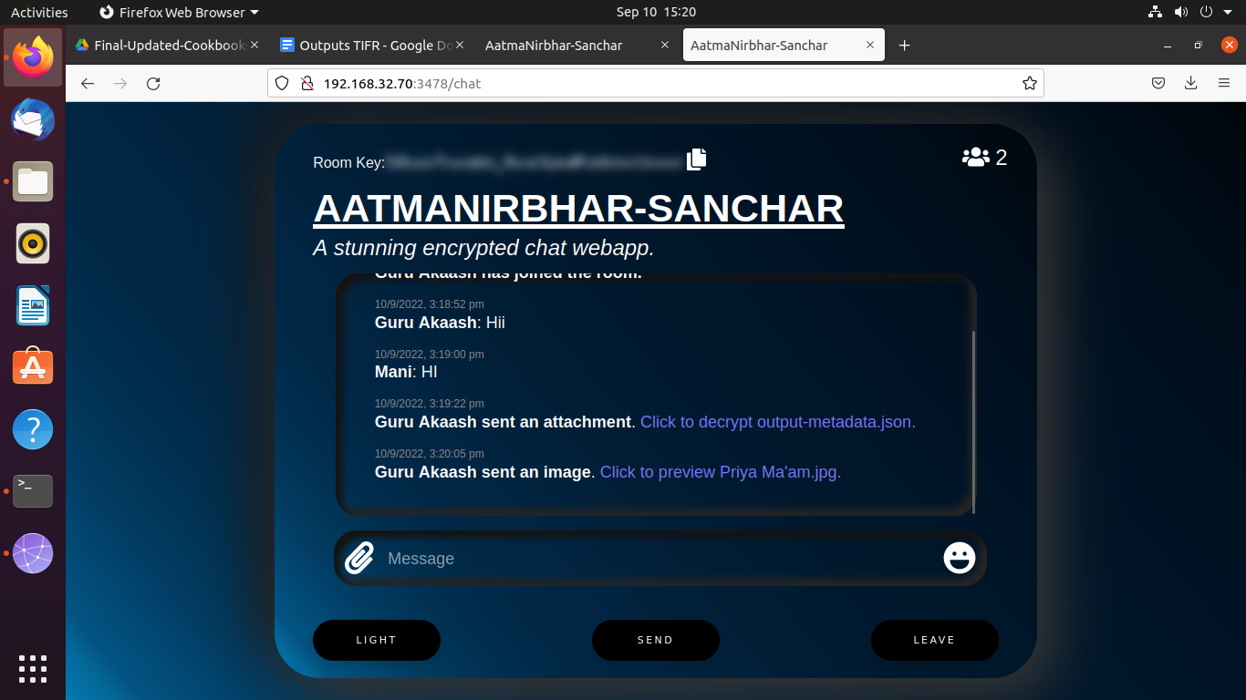
Results and Screenshots
Two users joining same room:
Sending Documents in room:

Slide 21
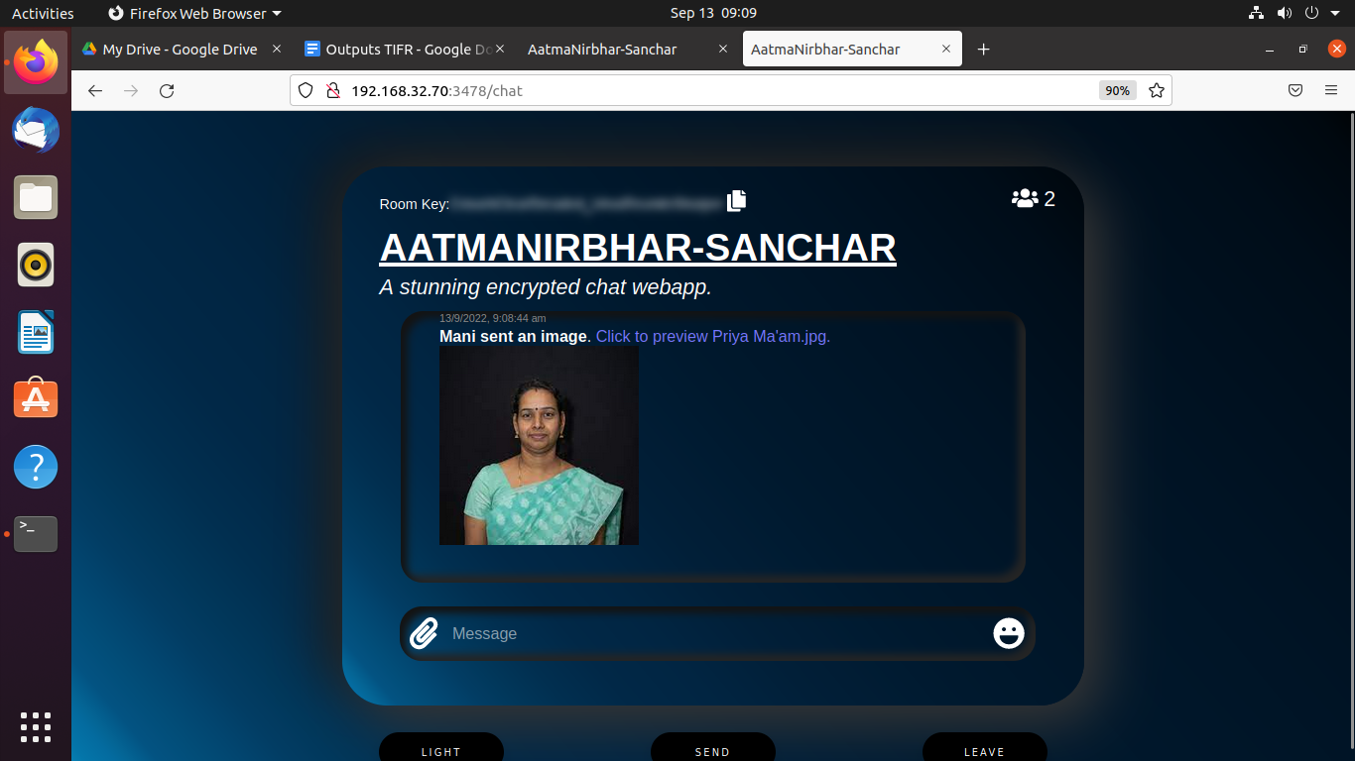
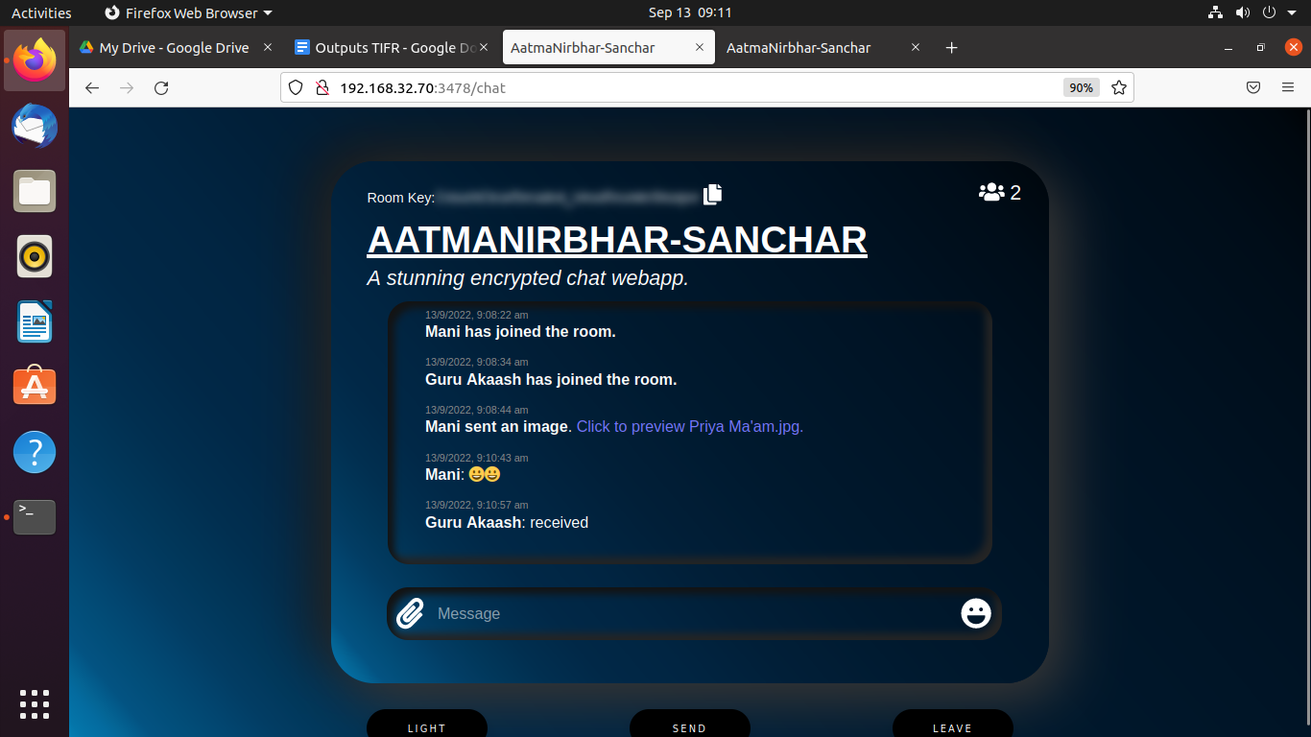
Results and Screenshots
Preview of the Document:
Received:

Slide 22
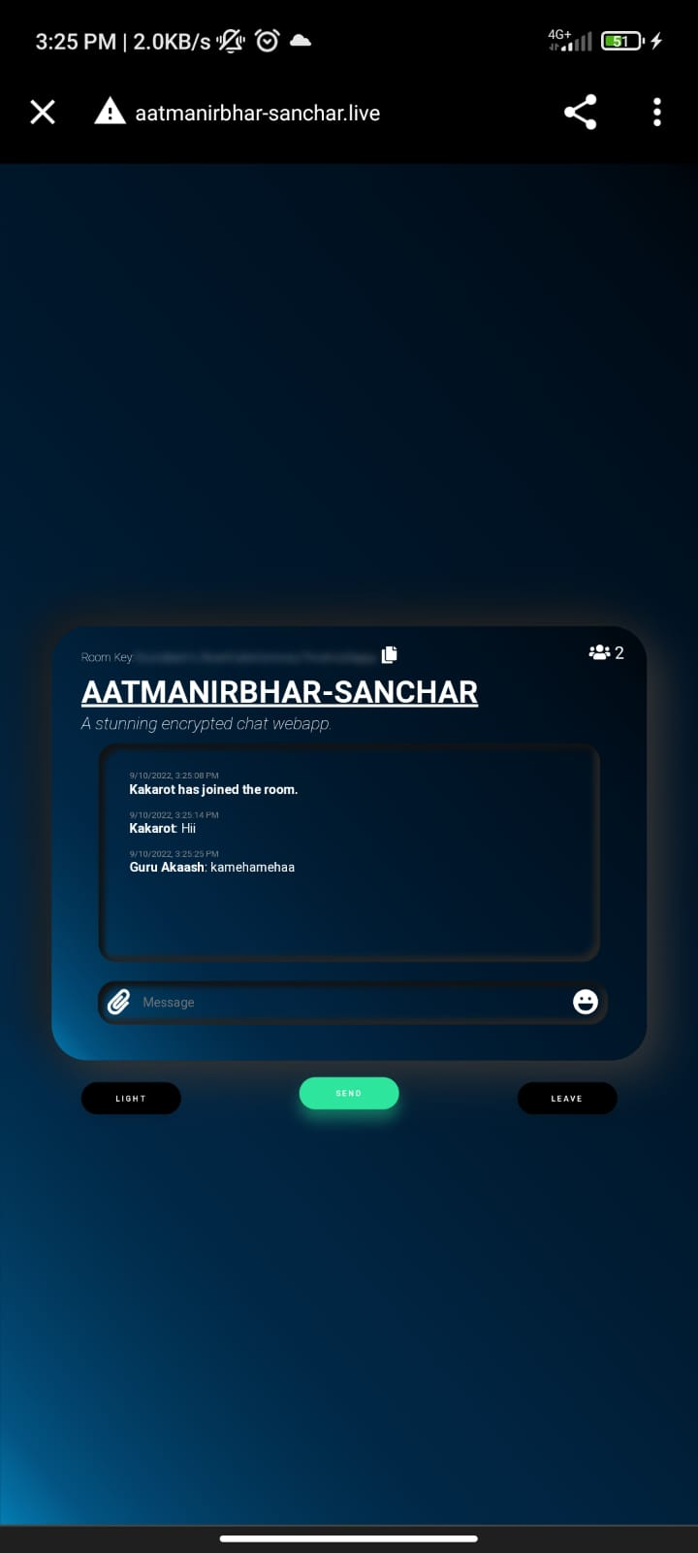
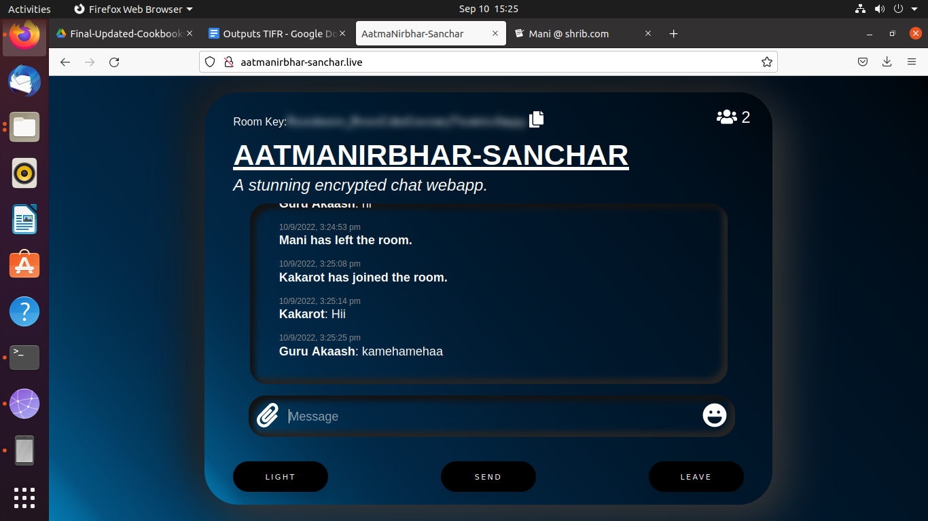
Results and Screenshots
Chatting with mobile:
Messages sent through mobile in web:

Slide 23
GSR: Gujarati Script
Recognition
Project Mentors :
Mrs. Priya R.L ,
Mrs. Nusrat Ansari
Group Number : 31
Group Members : Manigandan K D17A 47
J N Guru Akaash D17A 28
Ajay Nair D17A 55 Varun Tripathy D17A 69

Slide 24
Content
Project Overview
Hardware, Software
Challenges Faced
Results and implementation screenshots
References

Slide 25
Hardware and Software used
Hardware
Linux OS/ CentOS for development of the project.
GPU for CUDA and CUDnn
4GB RAM or 8GB RAM for smooth operation
5GB free space in memory for project run.
Software
Python 3.8 and above
PyQt, OpenCV and other open-source libraries
Git/ Github
SQLite Database

Slide 26
Challenges Faced
No proper value store sequence in the database.
Deprecated or unsupported dependencies. Uninstalling and reinstalling the latest version of the dependencies and libraries.

Slide 27
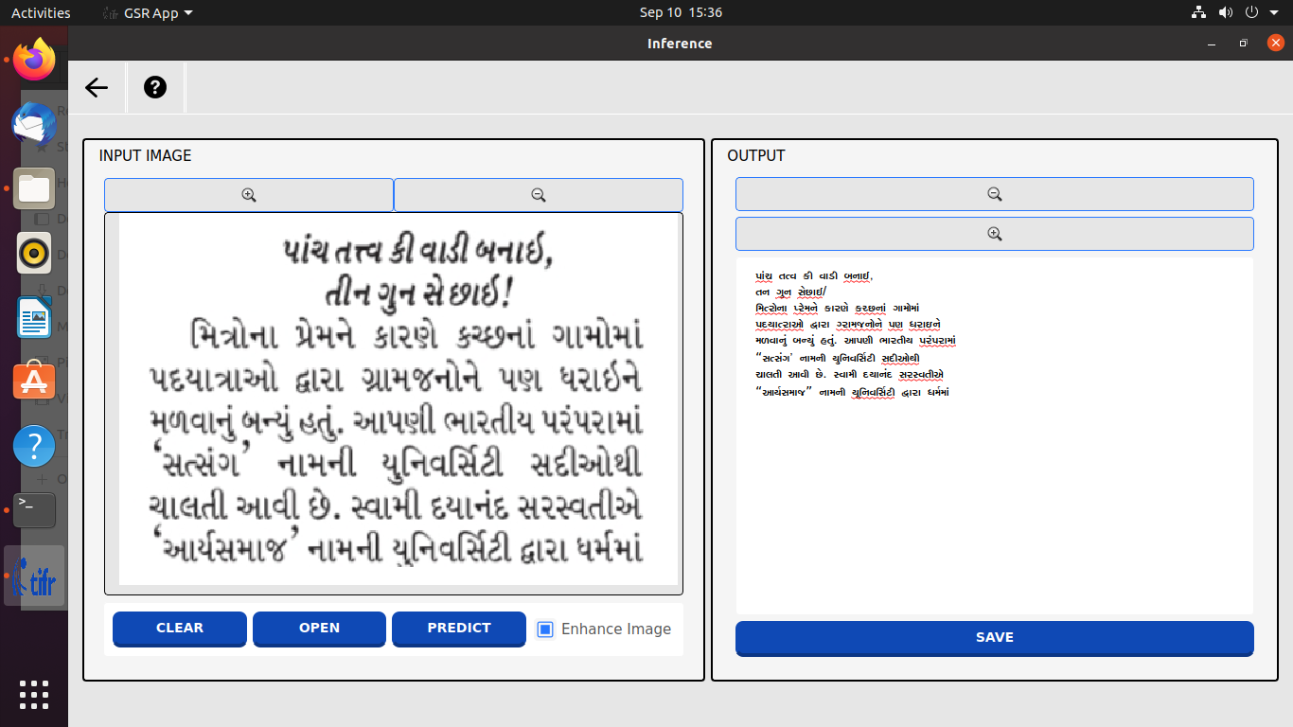
Results and Implementation screenshots
Testing Inference

Slide 28
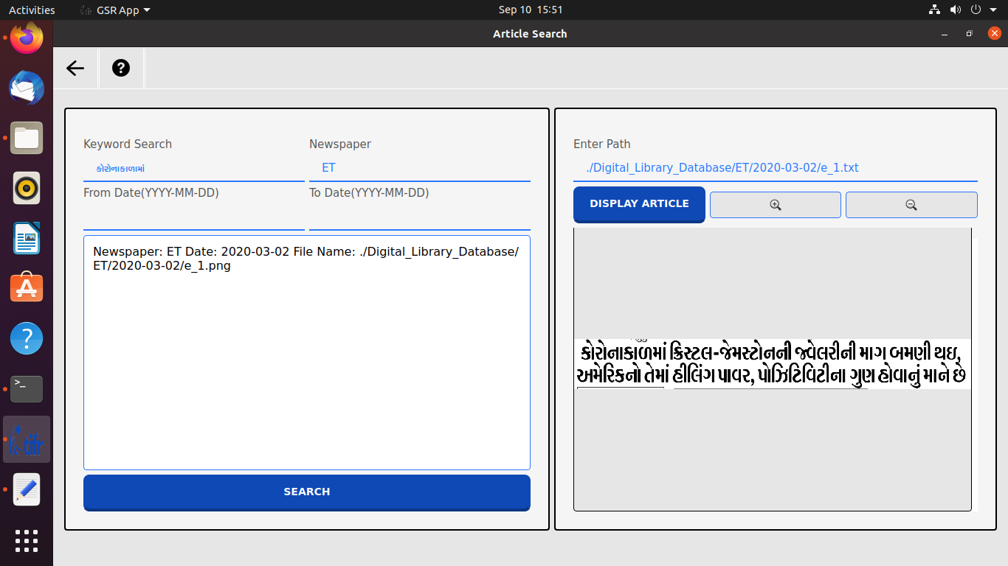
Results and Implementation screenshots
Testing Article Search

Slide 29
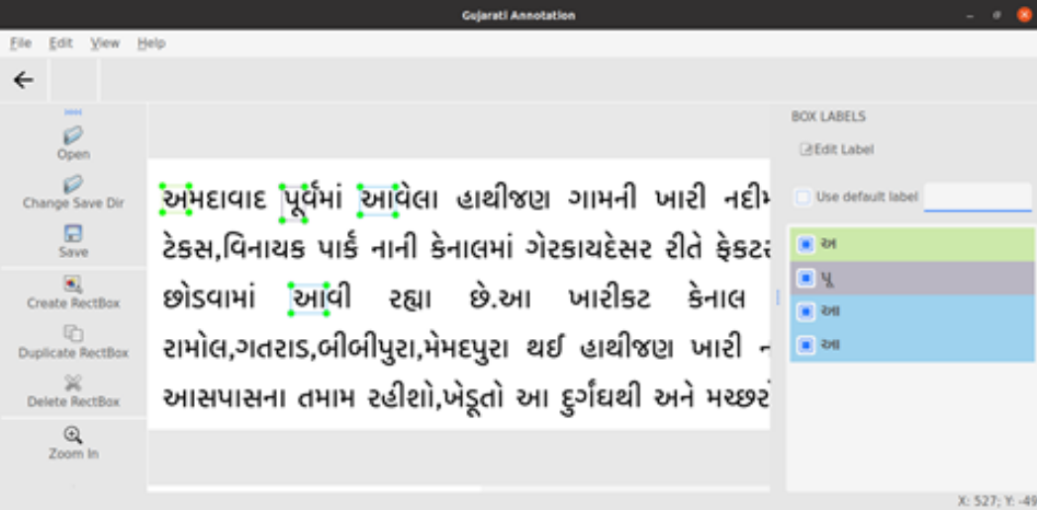
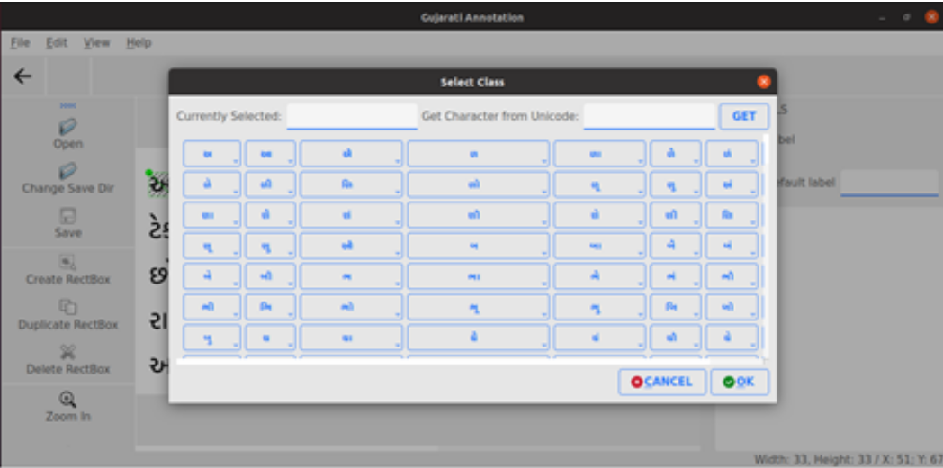
Results and Implementation screenshots
Annotation Tool

Slide 30
References
https://www.python.org/downloads/
https://www.python.org/downloads/source/
https://linuxize.com/post/wget-command-examples/
https://linuxize.com/post/how-to-extract-unzip-tar-gz-file/
https://linuxize.com/post/linux-cd-command/
https://drive.google.com/file/d/1CDfCaf58mDxmHIA_5yWv7Pkhx6b6PDQA/view?usp=sharing
https://pypi.org/project/pyenchant/

Slide 31
Quality assurance of silicon detectors in CMS experiment using automated visual inspection
Project Mentors :
Mrs. Priya R.L ,
Mrs. Nusrat Ansari
Group Number : 31
Group Members : Manigandan K D17A 47
J N Guru Akaash D17A 28
Ajay Nair D17A 55 Varun Tripathy D17A 69

Slide 32
Content
Introduction
Hardware, Software, tools and constraints
Challenges Faced
Results and implementation screenshots
References

Slide 33
Introduction
For the CMS experiment at CERN, Geneva a substantial number of HGCAL sensor modules are manufactured at advanced laboratories across the globe.
Each sensor module comprises around 675 checkpoints for visual inspection, making manual inspection practically unfeasible.
In the industrial environment of manufacturing these sensor modules, this task is awfully difficult due to diverse defect appearances, ambiguous intraclass, and interclass distances.
Due to recent technological advances, there has been a rise in automated visual inspections and intelligent quality assurance systems in manufacturing. In order to simplify this, we propose a deep-learning-based approach for defect diagnosis and subsequent quality assurance.

Slide 34
Hardware, Software, tools and constraints
Hardware:
Linux, TIFR GPU,Colab GPU
Software:
Cuda, Cudnn, Tensorflow, OpenCV, Darknet
Technology and Tools Used:
● LabelImg - It was used to the images
● Colab GPU - Colab GPU was used to accelerate the process
● Ubuntu 20.04 - OS used for the installation and setup of PyQt software
● GitHub - It was used to keep the data and to import in the Google Colab
Constraints
● Need High performance computing hardware
● Limited Dataset Quantity
● Reduce False Positives

Slide 35
Challenges Faced
Downloading and configuring cuda and cudnn and checking their compatibility with tensorflow
Understanding DarkNet repository and using it.
Training took a lot of time even with GPU.

Slide 36
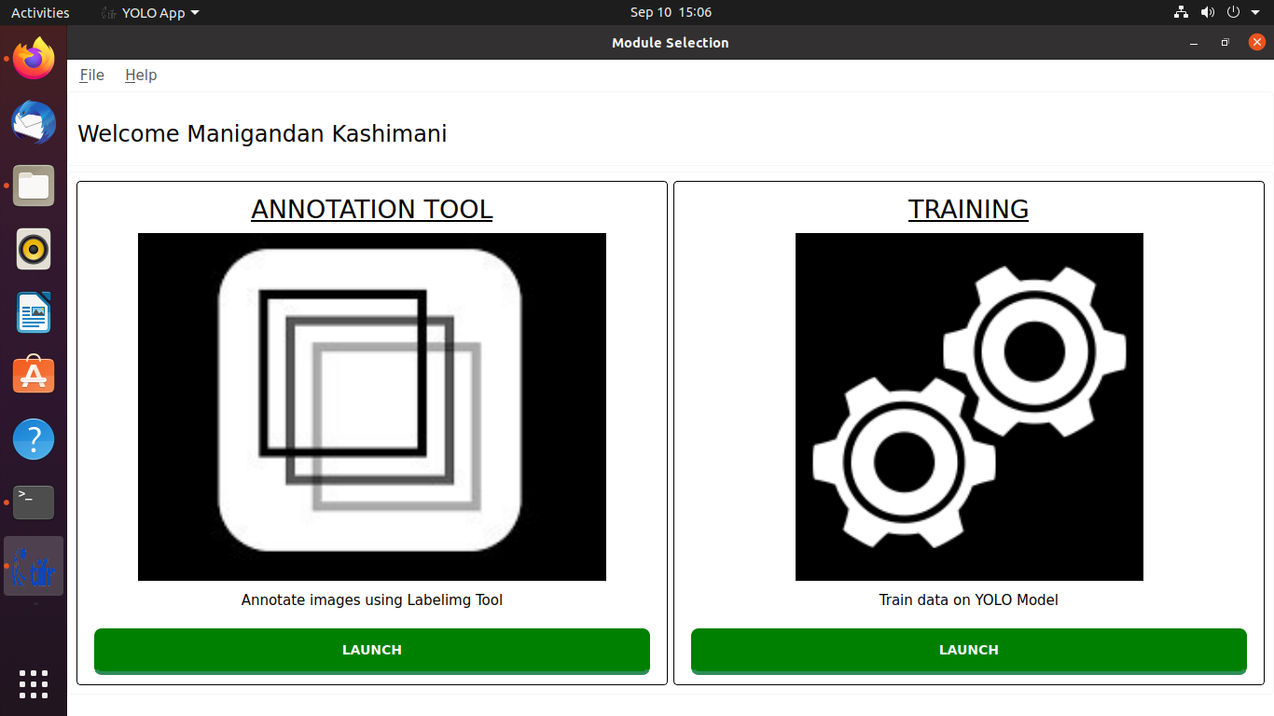
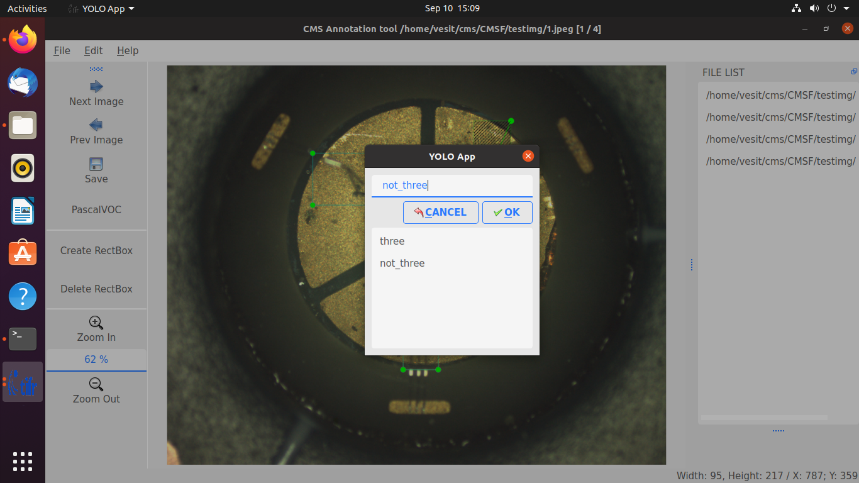
Results and implementation screenshots
CMS-Training
Annotation tools:

Slide 37
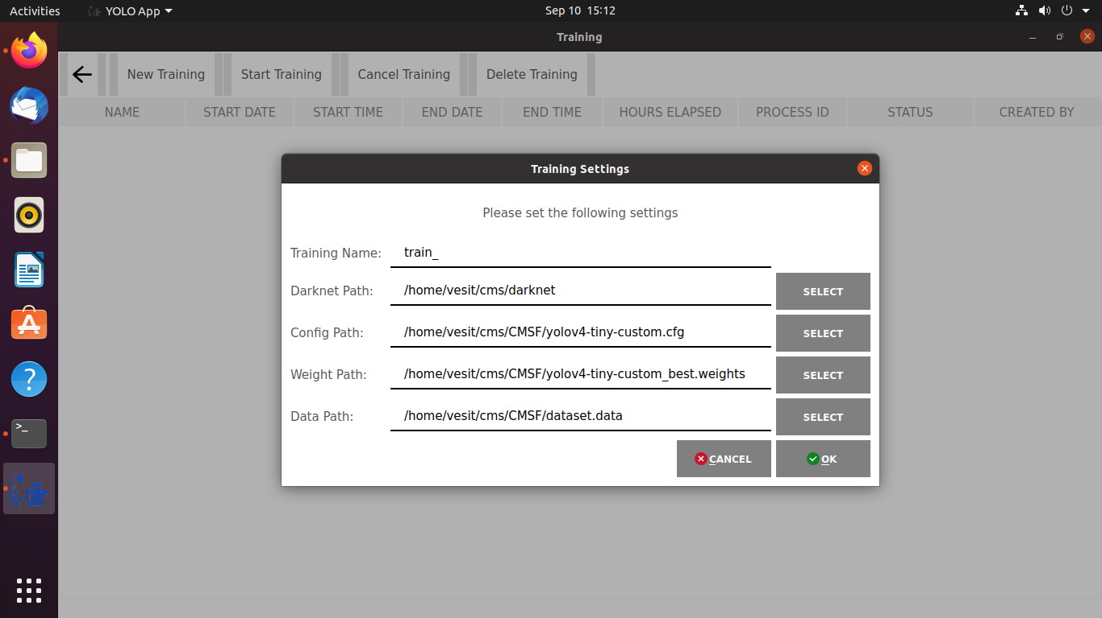
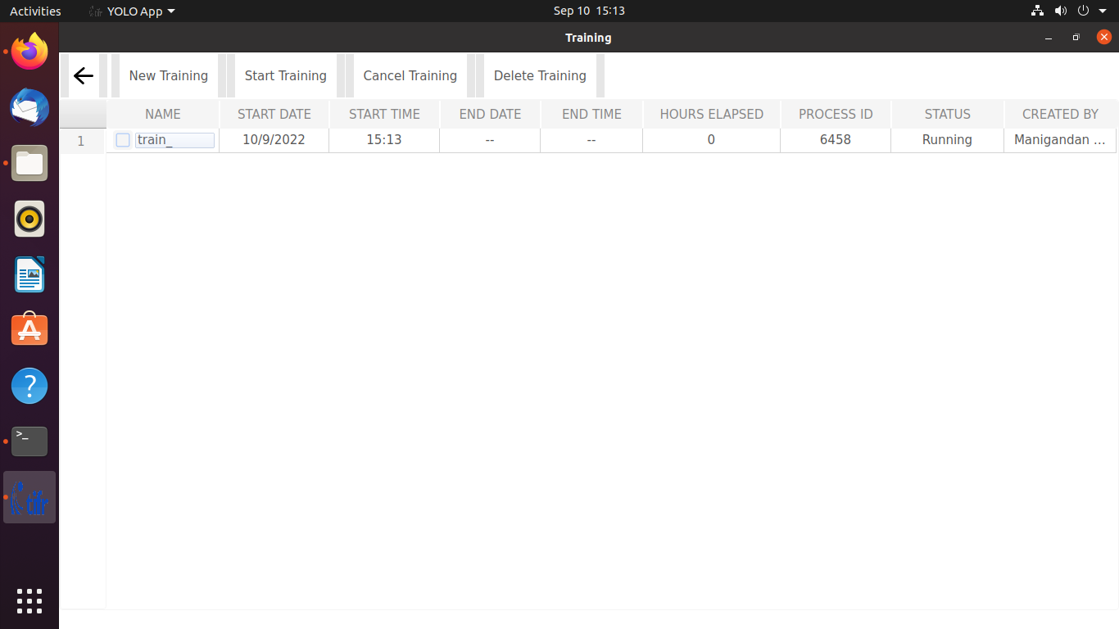
Results and implementation screenshots
Creating Training model
Training:

Slide 38
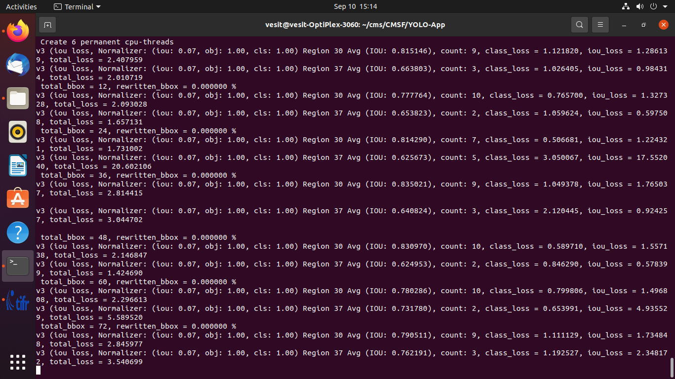
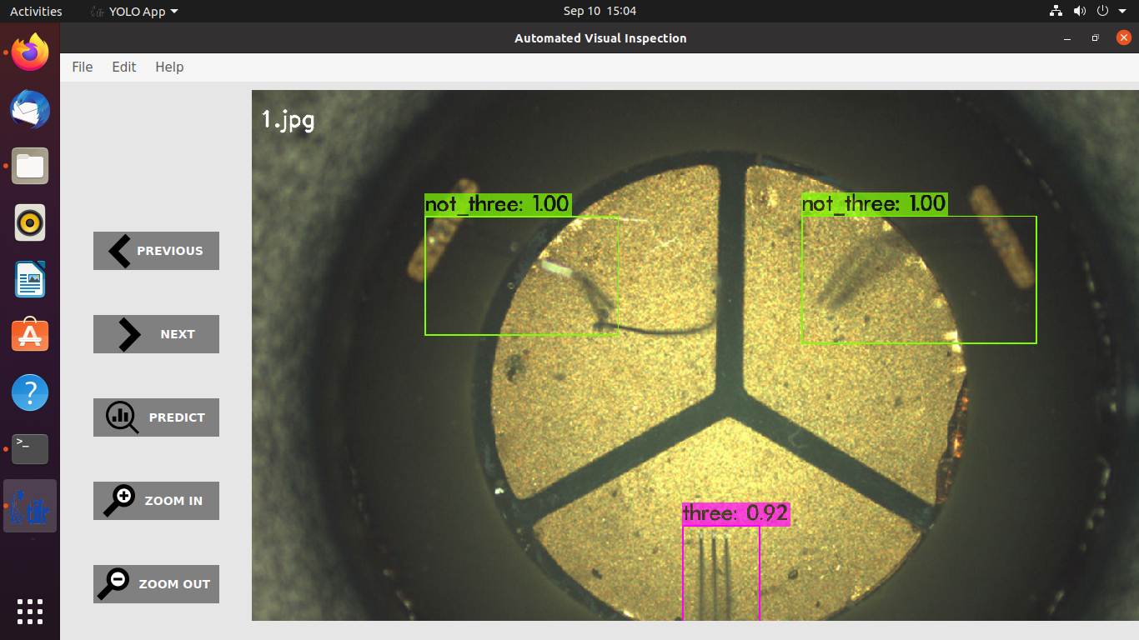
Results and implementation screenshots
Training process:
CMS Output - Testing:

Slide 39
References
[1] Richard C. Fernow Introduction to Experimental Particle Physics, Cambridge University Press.
[2] Donald H. Prekins, Introduction to High Energy Physics, Addison Wesley publishing company.
[3] David C. Cheng and Gerald K. O'Neill, Elementary Particle Physics, An Introduction, Addison Wesley publishing company
[4] Amol Dhenge, Pallavi Keskar, “Computer Vision Based Object Sorting & Fault Detection Using Ann”, IFERP, volume 1, Issue 5, April 2015

